Slide 1

Object Orientated Software Engineering
Maven
By Derek Somerville

Slide 2

Admin
Zoom

Slide 3
Intended Learning Outcomes
Discuss the breadth of software engineering.

Slide 4
Maven
What is Maven
Why have Maven
How Maven Works
Dependencies

Slide 5
What is Maven
A build tool, it compiles and creates the executable
Dependency Management Tool
A documentation tool

Slide 6
What is Maven
Apache Maven is a software project management and comprehension tool. Based on the concept of a Project Object Model (POM ), Maven can manage a project's build, reporting and documentation from a central piece of information.
https://maven.apache.org/

Slide 7
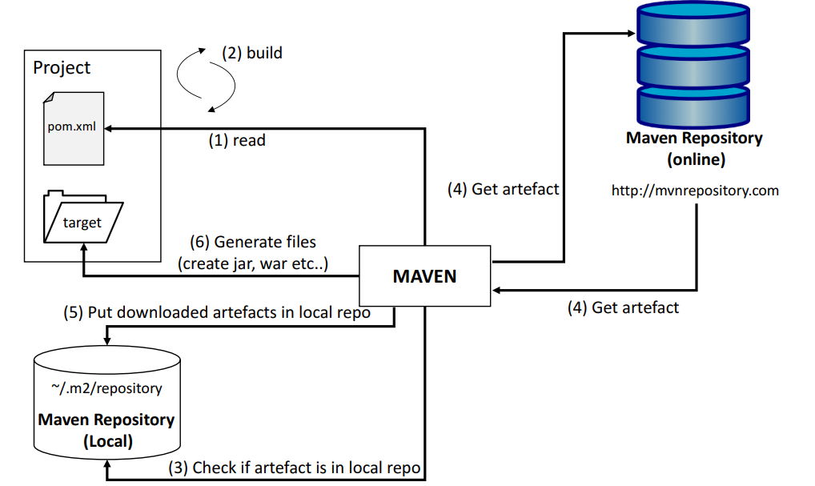
How Maven Works

Slide 8
Maven Project
Project Name (GAV) – a unique identifier for the project
groupId: Arbitary project grouping identifier (no spaces or colons)
artifactId: Arbitary name for the project (no spaces or colons)
version: Version of the project – Format {Major}.{minor}.{Maintenance}. Add ‘–SNAPSHOT’ to identify in development

Slide 9
Maven Project
<?xml version="1.0" encoding="UTF-8"?>
<project>
<modelVersion>4.0.0</modelVersion>
<groupId>gla.oose.s2</groupId>
<artifactId>ttdcardgamesevenssolution</artifactId>
<version>1.0-SNAPSHOT</version>
</project>

Slide 10
Maven Properties
maven.compiler.source – JDK Version Number
maven.compiler.target – JDK Version Number
Keep in sync with the LDE JDK version
This should be 17 for openjdk-17

Slide 11
Maven Properties
<properties>
<maven.compiler.source>17</maven.compiler.source>
<maven.compiler.target>17</maven.compiler.target>
</properties>

Slide 12
Directory Organisation
src/main/java
src/test/java
src/main/java/com/myCompany/app/App.java
src/test/java/com/myCompany/app/AppTest.java

Slide 13
Maven Dependencies
Why write a code if it has been written before
Libraries are code that have already been written
You can make use of the functionality in labraries
JUnit5 and assert
Make use of trusted libraries

Slide 14
Maven Dependencies
Maven finds the dependency and downloads the library
One dependency might have other dependencies or libraries they use
The library is cached to a local repository - ${user.home}/.m2/repository
Repositories follow a simple directory structure
{groupId}/{artifactId}/{version}/{artifactId}-{version}.jar
groupId ‘.’ is replaced with ‘/

Slide 15
Maven Dependencies
Maven Central is primary community repo
http://repo1.maven.org/maven2

Slide 16
Maven Dependencies Version
Hackers find bugs in code
Developers fix the bugs creating new versions
Check for the latest trusted versions
https://mvnrepository.com/

Slide 17
Maven Dependencies Version
<dependencies>
<dependency>
<groupId>org.junit.jupiter</groupId>
<artifactId>junit-jupiter</artifactId>
<version>5.6.0-M1</version>
<scope>test</scope>
</dependency>
</dependencies>

Slide 18
Maven Load
Eclipse
pom.xml – right click/Maven/Update Project
Menu project/Update Maven Project
IntelliJ
pom.xml right click/Maven/Reload Project

Slide 19
Maven
What is Maven
Why have Maven
How Maven Works
Dependencies

Slide 20

Lecture – Any Questions

